Slide 1
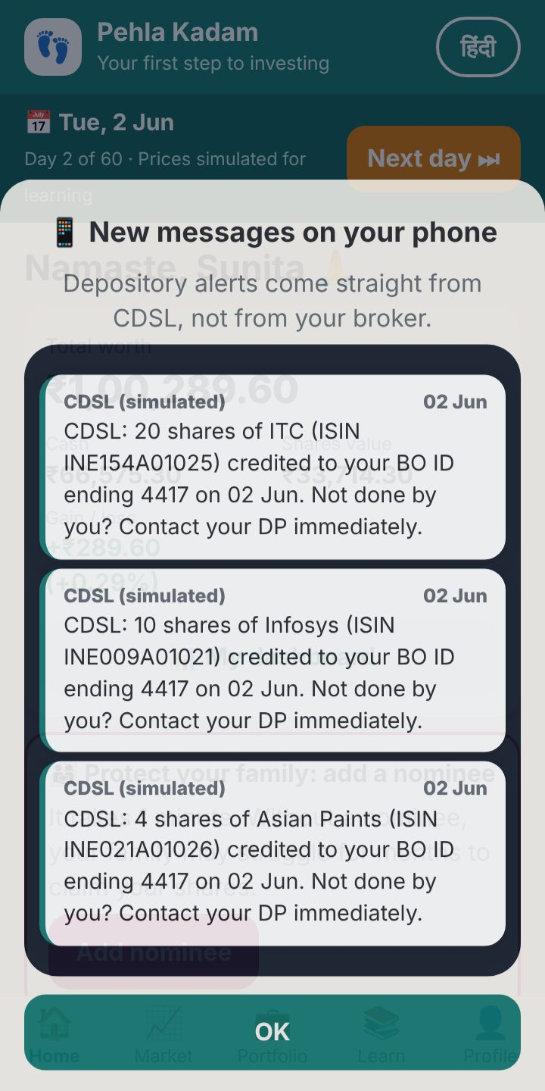
CDSL REIMAGINE IDEATHON 2026
Pehla Kadam
पहला कदम
Learn investing where your shares actually live: a practice demat account that teaches the depository, in Hindi and English.
[Team name] · [Member names] · Working prototype, all money and prices simulated
Notes:
Namaste. We are [team name]. Pehla Kadam means “first step”. It is a practice demat account for first-time investors, especially women in tier-2 and tier-3 towns. Unlike a trading game, it teaches what happens at the depository: settlement, alerts, statements, corporate actions, nominees and scam protection. Everything you will see is a working prototype you can open today.

Slide 2
Broker apps stop at the Buy button
THE GAP
What a new investor sees
What nobody explains
A price and a Buy button
A chart that goes up and down
Profit and loss in green and red
Tips and “trending stocks”
Where shares live: a demat account at CDSL
Why they arrive the next day (T+1)
Who protects them: TPIN, alerts, CAS
Nominees, dividends, bonus, pledges
That missing layer is the depository. It is where trust is built, and where scams like “share your OTP” do their damage.
Notes:
Today a first-time investor downloads a broker app and sees a price, a chart and a green number. Nobody shows them where the shares actually live, why they arrive the next day, who keeps them safe, or what to do when a stranger asks for an OTP. That missing layer is CDSL’s world: the depository. It is exactly where confidence, and protection, comes from.

Slide 3
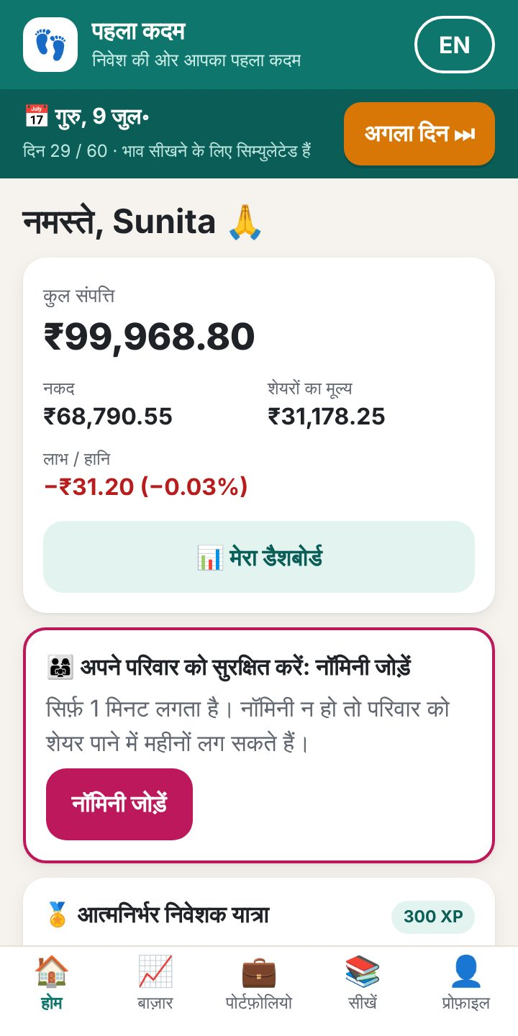
First-time investors in tier-2 and tier-3 towns, especially women
WHO IT’S FOR
हिंदी + English
₹0 at risk
Any phone
One tap switches every button, lesson, alert and scam message.
Practice money, demo KYC, simulated prices. Mistakes become lessons.
No sign-up. Opens on a basic phone and works offline.
“Many women never find out about shares a husband or father held. A nominee makes sure your savings reach the people you love.” Sakhi, the in-app guide
Notes:
We designed for a woman in Indore, Nashik or Gorakhpur opening her first demat account. Everything is in Hindi and English, nothing is at risk, and it works on a basic phone. Sakhi, an in-app guide, explains each step at the moment it happens, instead of in a glossary nobody reads.

Slide 4
THE IDEA
Every tap teaches what the depository does
₹1,00,000
60 days
8 flows
practice money, no real rupee at stake
of simulated market, one tap per day
from KYC to e-voting, each with a lesson
Notes:
The idea in one line: a practice demat account where every action teaches what the depository does. Learners get one lakh rupees of practice money, ten familiar large companies with clearly labelled simulated prices, and a “Next day” button that moves the calendar so settlement, dividends and statements actually happen in front of them.

Slide 5
Follow 20 ITC shares through one month
HOW IT WORKS
T · Mon 1 Jun
T+1 · Tue 2 Jun
Fri 5 Jun
Thu 11 Jun
Wed 17 Jun
Wed 1 Jul
Buy
Credited
Dividend
Bonus 1:1
Split 1 → 5
CAS arrives
Cash leaves today. Shares show as “pending”.
Shares land in the demat account, with a CDSL alert.
₹6.50 × 20 = ₹130, with a lesson on record dates.
Infosys holders get a free share each. Value stays the same.
Five times the shares at a fifth of the price.
The monthly statement to check against your own records.
Tap “Next day ⏭” and the depository does its work. This is exactly what a learner sees.
Notes:
The prototype runs on a simulated calendar. A learner buys twenty ITC shares on day one; the money goes immediately, but the shares arrive the next trading day with a CDSL alert. That is T+1 settlement, felt rather than read. Then the dividend lands on its record date, Infosys does a bonus, Asian Paints splits, and at month end the CAS statement arrives. Each event opens a short lesson showing what happened to their own holdings.

Slide 6
Eight flows, each one working and teaching
WHAT LEARNERS DO
Open an account
Buy and sell
Holdings and CAS
Corporate actions
Demo KYC, broker as DP, 16-digit BO ID, TPIN.
T+1 settlement, CDSL alerts, TPIN to approve a sale.
Average price, gain/loss and a monthly statement.
Dividend, bonus and split on fixed days.
Pledge
Nominee
E-voting
Scam Shield
CDSL OTP, haircut, margin that falls with prices.
Add one in a minute, or see what family faces without.
An AGM resolution in three plain lines.
Judge five WhatsApp messages: safe or scam?
Notes:
There are eight flows, and every button works end to end. Each one teaches the concept behind it: account opening, buying and selling with T+1 and TPIN, the CAS statement, corporate actions, pledging and its risks, nomination, e-voting, and a Scam Shield game. Sixteen short lessons from Sakhi back them up, in both languages.

Slide 7
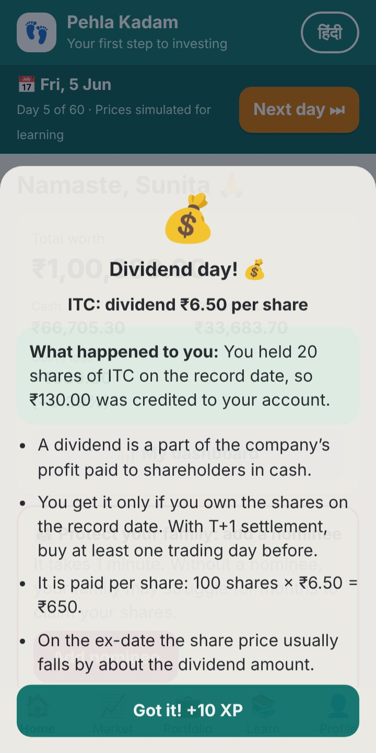
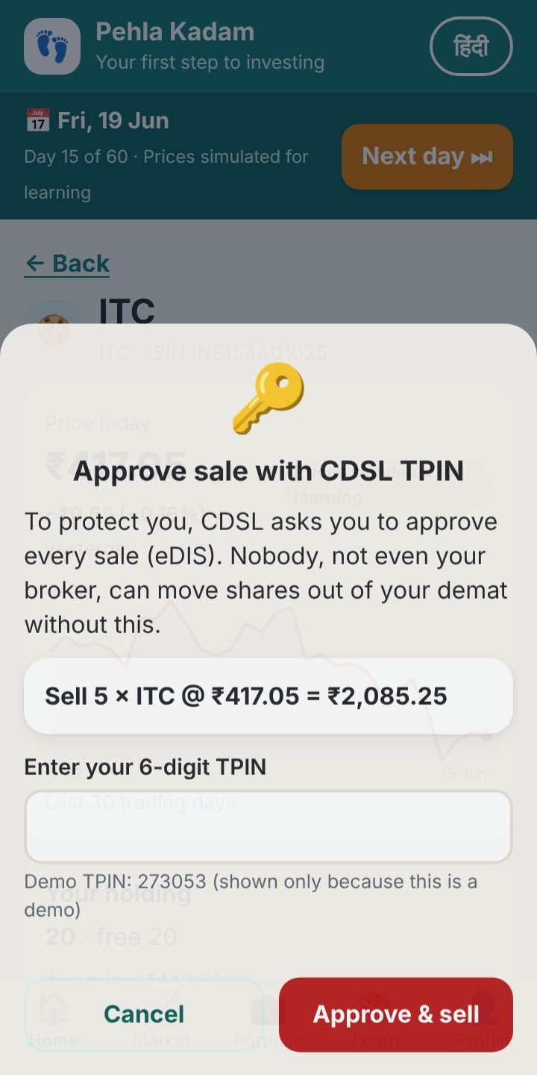
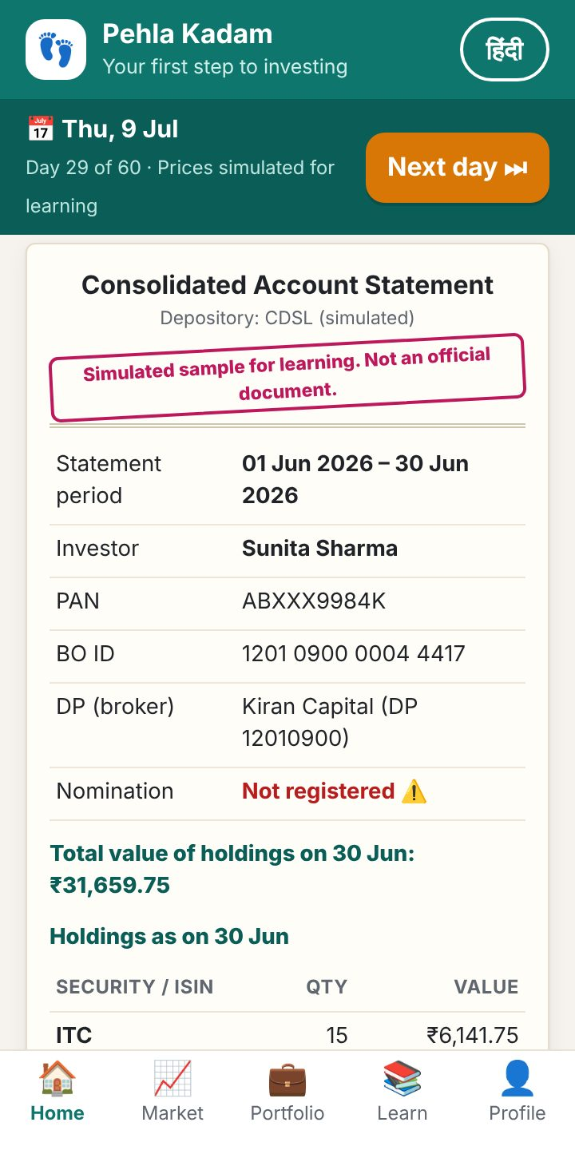
The depository, made visible
INSIDE THE APP
T+1 alerts
straight from the depository
Dividend day
what happened to you, then why
TPIN to sell
nobody moves your shares without you
Monthly CAS
independent proof of what you own
Notes:
These are real screens from the prototype. First, the CDSL alerts that arrive when shares settle. Second, a dividend lesson that starts with what happened to the learner’s own holding. Third, selling: CDSL asks for the TPIN, so the learner sees that nobody can move their shares without them. Fourth, the monthly CAS statement, with nominee status and a checklist of what to look for.

Slide 8
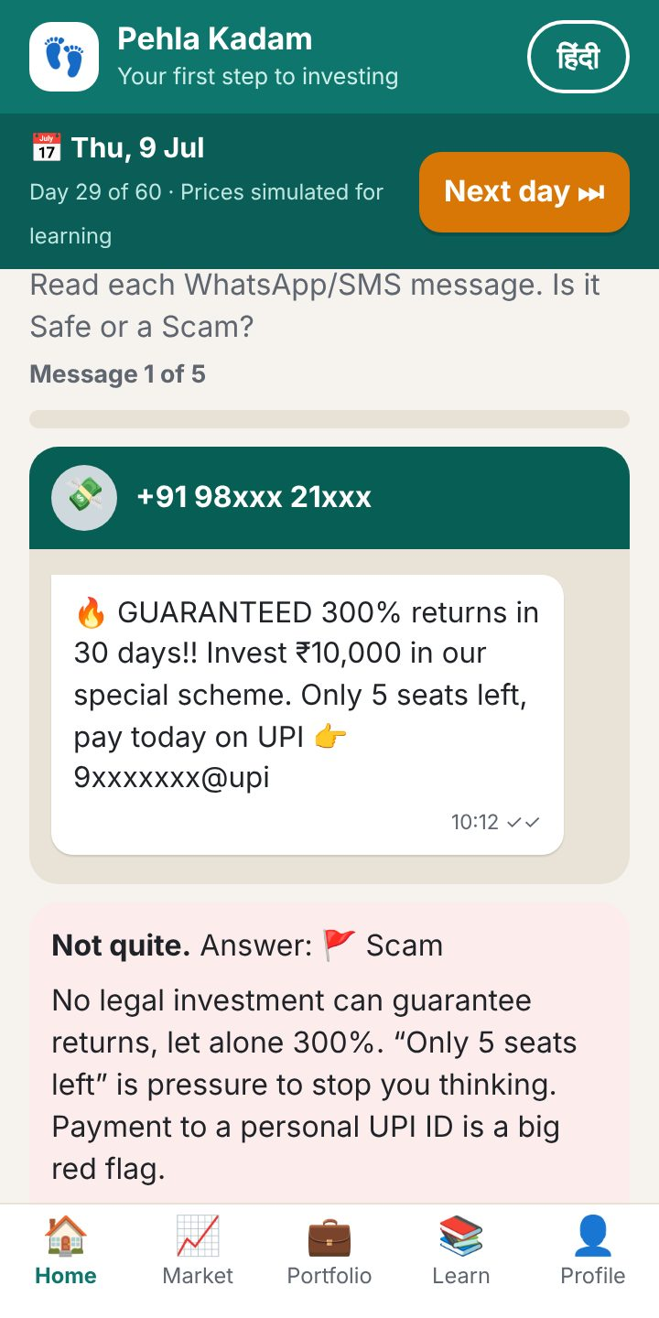
Learners practise saying no before real money is at stake
PROTECTION IS PART OF THE LESSON
1
Scam Shield
Five real-looking WhatsApp messages: “300% guaranteed”, a fake KYC block asking for TPIN and OTP, an unregistered “stock guru”. Then how to check SEBI registration and report to 1930.
2
Nominee prompt
Asked right after the account opens. Skipping it explains the legal-heir paperwork a family would face.
3
Alerts, TPIN and pledge risk
Every share movement brings a CDSL alert; every sale and pledge needs the learner’s own approval.
Notes:
Protection is built into the learning, not added as a warning banner. Scam Shield shows five realistic WhatsApp messages and asks: safe or scam? Every answer explains the red flags and how to check SEBI registration. The nominee prompt appears right after the account opens, and skipping it explains what a family would go through. And because every sale and pledge needs the learner’s own TPIN or OTP, they learn that nobody else can move their shares.

Slide 9
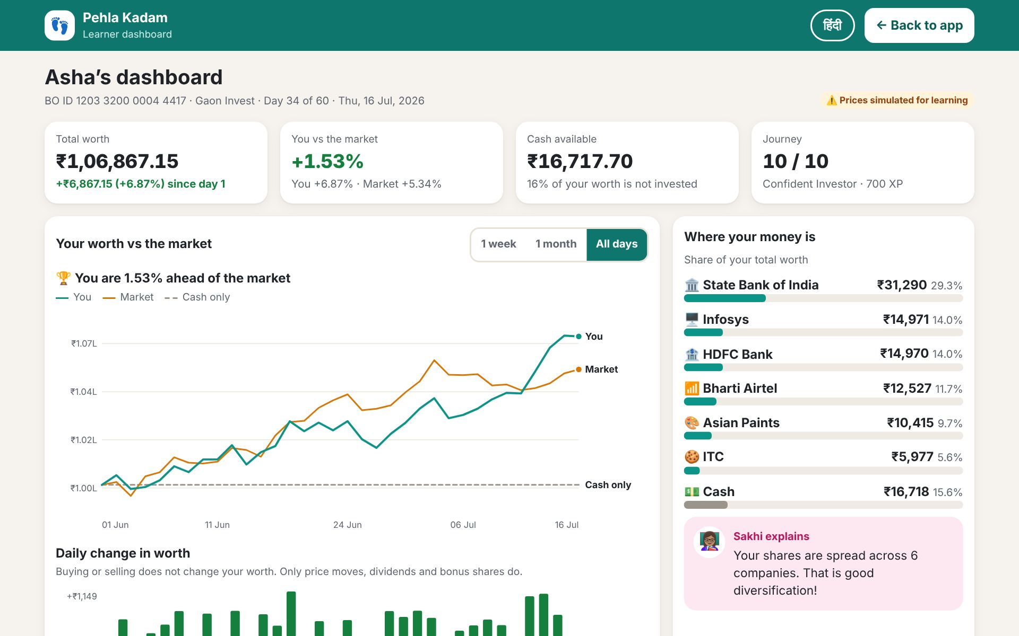
Everything a learner did, on one page
LEARNER DASHBOARD
Worth vs the market vs cash
Every event tagged T or T+1
Where the money is, and a diversification tip
Learning progress and a safety check
Notes:
The full-page dashboard pulls it together: the learner’s worth against an equal-weight market and against just keeping cash, daily gains and losses, holdings, a ledger of every depository event tagged T or T+1, income from corporate actions, and a safety check that links to whatever still needs fixing. It updates live while the app is open in another tab, and before you start it shows a clearly labelled example learner.

Slide 10
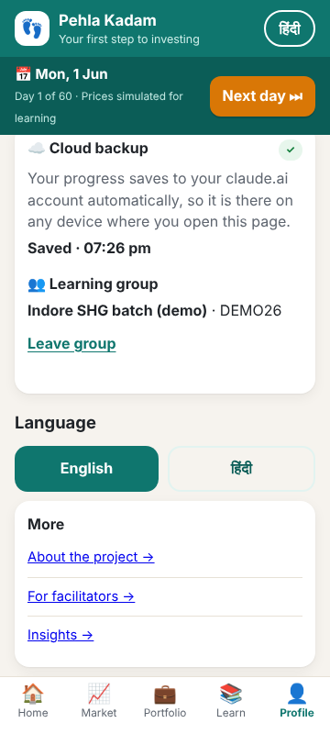
Your progress follows you to any phone
CLOUD BACKUP
1
Saved automatically
On the hosted claude.ai page it saves to the learner’s own account with no PIN; on our own server, with mobile number and a PIN.
2
Private by design
PAN, Aadhaar, mobile and trades stay in the learner’s private space. Facilitators see only names and progress.
3
Still works offline
With no network the app keeps going on the phone and saves again when it can.
Notes:
A practice account is only useful if it is still there tomorrow. On the hosted claude.ai page, progress saves to the learner’s own claude.ai account automatically, with no PIN to remember, and comes back on any device. On our own server, learners back up with their mobile number and a PIN. Either way, personal details like PAN, Aadhaar and mobile, and every trade, stay in the learner’s private space; facilitators only ever see names and progress. And with no network, the app keeps working on the phone.

Slide 11
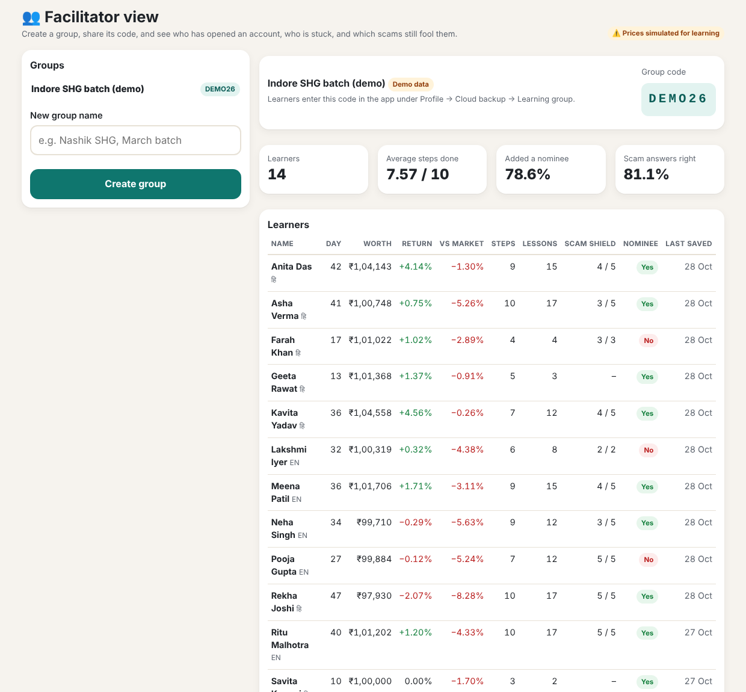
Facilitators see who is stuck. CDSL sees what confuses people.
BEYOND ONE PHONE
SHG leaders and NGO trainers open the facilitator view inside the app, create a group and share a 6-letter code.
Anonymous insights show everyone which steps learners skip and which scams still fool them.
Screen shows the seeded demo group; no real learner data.
Notes:
Learning sticks better in groups. A self-help-group leader or NGO trainer opens the facilitator view inside the app, creates a group and shares its six-letter code; learners join from their own phone. The facilitator sees who has opened an account, who is stuck at which step, who has not added a nominee, and which scam messages still fool the group. On the hosted page, anyone the owner shares it with as an editor becomes a facilitator. Across all learners, an anonymous insights page tells CDSL which concepts confuse new investors most. This screen uses our seeded demo group.

Slide 12
Offline on any phone, with two ways to sync
HOW IT IS BUILT
Phone app
Hosted on claude.ai
Built-in database: automatic backup, groups and insights with nothing to deploy. For people in our organization.
One 239 KB HTML file. Runs offline in Hindi and English, with progress saved on the phone.
Our own server
Node.js and SQLite on any public URL. Re-checks every trade against the price engine and keeps a full depository ledger.
24 automated tests, including a price-parity check against the app
Backup and restore across phones, with conflict handling
Access rules: learners never see each other’s data
Free to run on claude.ai or Render’s free plan
Notes:
The learner app is a single 239-kilobyte HTML file. It needs no network, no sign-up and no app store, so it runs on a basic phone. It can sync two ways. Hosted on claude.ai, it uses the page’s built-in database: backup, groups and insights work with nothing to deploy, for people in our organization. On our own Node.js and SQLite server, which can run on any public URL including Render’s free plan, the server never trusts the phone: it replays every trade against the same simulated price engine and refuses anything that does not add up, then writes a proper depository ledger. Twenty-four automated tests cover the server.

Slide 13
From prototype to every town, with CDSL
WHAT COMES NEXT
01 · Pilot
02 · Languages
03 · First real step
Run it with real groups
Beyond Hindi and English
Hand off to a real account
[2–3] DPs and SHG networks in [districts]. Measure confidence before and after with a short quiz.
Marathi, Bengali, Tamil and more. Every string already lives in one translation file.
A guided move from practice to opening a demat account with a DP, using CDSL’s own alert and statement formats.
Notes:
Our proposed next steps. First, a pilot with a few depository participants and self-help-group networks, measuring confidence with a short quiz before and after. Second, more languages; every string already lives in one translation object, so adding Marathi or Tamil is translation work, not engineering. Third, a bridge to the real thing: when a learner is ready, a guided hand-off to opening an actual demat account with a DP, using the same alert and statement formats they practised with. The bracketed items are ours to fill in with CDSL.

Slide 14
TRY IT YOURSELF
Three minutes, one first step
1 · Open an account
2 · Buy ITC on day 1
3 · Check what you own
Tap “Fill demo details”, pick any broker, note your BO ID and TPIN.
Tap “Next day” a few times: the CDSL alert, then the dividend on 5 June.
Open the CAS and the dashboard, then try Scam Shield.
Live demo: [Render URL] · Code: github.com/TushKum/cdsl
[Team name] · [Contact email] · All money, accounts and prices in the prototype are simulated.
Notes:
Please try it yourselves: it takes about three minutes. Open an account with demo details, buy some ITC on day one, tap “Next day” and watch the CDSL alert and then the dividend arrive. Open the CAS statement and the dashboard, and try Scam Shield. Pehla Kadam is the first step to becoming an Atmanirbhar investor. Thank you.

